Slide 1
RENAL DISORDERS
NUR -224

Slide 2
Objectives
Differentiate between the causes of acute and chronic kidney failure.
Describe the nursing management of patients with acute and chronic renal failure.
Compare and contrast renal replacement therapies.

Slide 3
Glomerulus
Glomerulus is a tuft of capillaries surrounded by the Bowman’s capsule.
The amount of fluid filtered from the blood into the capsule /min is called the glomerular filtration rate
99% of the filtrate is reabsorbed in the renal tubules.
Glomerular disease affects both the structure and function of the glomerulus & is the leading cause of CKD in the US.

Slide 4
Glomerular Disease
Glomerular disease affects both the structure and function of the glomerulus disrupting glomerular filtration.
Capillary membrane becomes more permeable to plasma proteins and blood.
This increased permeability causes → hematuria, proteinuria, and edema.
As the GFR falls, → azotemia

Slide 5
Glomerular Disease
Loss of plasma proteins leads to hypoalbuminemia → edema.
As plasma proteins are lost, filtration increases.
This stimulates renin-angiotensin-aldosterone mechanism → vasoconstriction & salt/water retention
As the GFR continues to fall→ oliguria and hypertension

Slide 6
ACUTE GOLMERULONEPHRITIS
Inflammation of the glomeruli capillary membrane
Results from systemic diseases/primary glomerular diseases
Post-streptococcal glomerulonephritis – most common
Antigen/antibody complexes form during the primary infection and become trapped in glomerular capillaries → inflammatory response

Slide 7
ACUTE NEPHRITIC SYNDROME
Risk factors
Impetigo
Group A beta-hemolytic streptococcal infection
Acute viral infections
Hepatitis B
Primarily a childhood disease

Slide 8
ACUTE NEPHRITIC SYNDROME
Clinical manifestations
Hematuria
Edema –low pressure areas
Azotemia
Proteinuria
Hypertension
Prognosis less favorable for adults.

Slide 9
ACUTE NEPHRITIC SYNDROME
Assessment/Diagnostic Findings
Throat/skin cultures
KUB abdominal x-ray
Serum BUN /creatinine levels
Urinalysis
Kidney biopsy

Slide 10
ACUTE NEPHRITIC SYNDROME
Medical Management – Medications
no medication available to cure the disease
used to treat the underlying cause, reduce inflammation, manage the symptoms
Antibiotics
Oral glucocorticoids
Antihypertensive

Slide 11
ACUTE NEPHRITIC SYNDROME
Nursing Management / Excessive Fluid volume
Monitor vital signs
Record intake/output
Maintain fluid restriction as ordered
Monitor for desired effects of prescribed medication
Provide frequent position changes
Arrange dietary consultation

Slide 12
CHRONIC GLOMERULONEPHRITIS
Repeated episodes of acute nephritic syndrome
Kidneys reduced to one-fifth of their normal size.
Glomeruli/tubules become severely scarred
Reflects the end-stage of glomerular inflammatory disease.
May require renal transplant

Slide 13
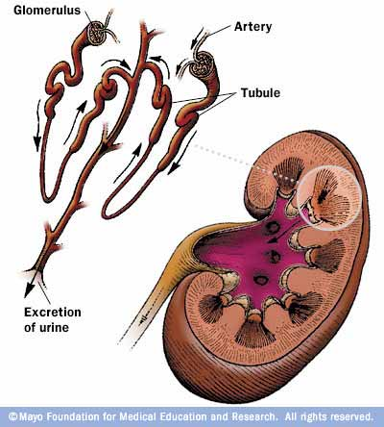

Slide 14
CHRONIC GLOMERULONEPHRITIS
May have no symptoms for many years
General symptoms –
loss of weight, increasing irritability, nocturia,
gray pigmentation
periorbital/peripheral edema

Slide 15
CHRONIC GLOMERULONEPHRITIS
Assessment/Diagnostic Findings
electrolyte changes
anemia
CXR, CT-scan
Mental status changes

Slide 16
CHRONIC GLOMERULONEPHRITIS
Medical management
Symptoms guide the treatment.
Manage hypertension
Diet/weight
Dialysis

Slide 17
KIDNEY FAILURE
Results when the kidneys cannot remove wastes or perform regulatory functions
A systemic disorder that results from many different causes
Acute kidney failure is a reversible syndrome that results in decreased GFR and oliguria
Chronic kidney failure (ESRD) is a progressive, irreversible deterioration of renal function that results in azotemia

Slide 18
ACUTE KIDNEY FAILURE
Rapid loss of renal function due to damage of the kidneys
Slight deterioration in kidney function → severe impairment
Increase in serum creatinine
Decrease in urine output
Development of azotemia

Slide 19
ACUTE KIDNEY FAILURE (AKI)
Pathophysiology
May be a specific underlying problem → problem that will reduce blood flow to the kidneys
Conditions should be treated and corrected before there is permanent damage to the kidneys.

Slide 20
Categories of Acute Renal Failure
Prerenal
Intrarenal
Postrenal

Slide 21
PRERENAL
factors external to the kidneys
occurs in 60-70% of cases
factors reduce systemic circulation → reduction in renal blood flow →decrease glomerular perfusion
if condition persists → kidneys lose their ability to compensate causing damage to renal tissues.
dehydration, excessive diuresis, heart failure, neurologic injury, burns

Slide 22
INTRARENAL
Cause direct damage to the kidney tissue → impair nephron function
ATN/acute tubular necrosis – common cause
Caused by prolonged ischemia or nephrotoxins – responsible for 90% of intrarenal cases
Nephrotoxins – obstruction of intrarenal structures – slough off and plug the tubules

Slide 23
POSTRENAL
Involve mechanical obstruction in urine outflow
As urine flow is obstructed - urine refluxes into the renal pelvis → impaired renal function
Causes – BPH, prostate cancer, calculi, tumors
Post renal causes of AKI account for less than 10% of AKI cases.

Slide 24
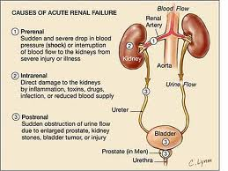

Slide 25
CLINICAL MANIFESTATIONS
Prerenal/postrenal usually resolve quickly with correction of the cause.
AKI has a prolonged course – progress through phases.
Phases:
initiation
oliguric
diuretic
recovery

Slide 26
OLIGURIC PHASE
Increase in serum concentration of substances usually secreted by the kidneys
Urine output needs to be at least 400mL/day
Oliguria – most common manifestations
Fluid volume
Hyperkalemia
BUN/Creatinine
Neurologic status

Slide 27
DIURETIC PHASE
Gradual increase in urine output –
1-3L/day, nephrons may still not be
fully functional
Lasts from 1-3 weeks
Kidneys have recovered their ability to excrete waste but not to concentrate urine
Monitor for hypervolemia, hypotension

Slide 28
RECOVERY PHASE
Improvement of renal function (may take several months)
Lab values return to normal

Slide 29
ASSESSMENT/DIAGNOSTIC FINDINGS
Prerenal – dehydration, blood loss, heart disease
Intrarenal – nephrotoxic drugs, hx of blood transfusions, radio opaque contrast media
Postrenal- stones, BPH, cancer - bladder/prostate
Ultrasonography
Urinalysis
Renal Biopsy

Slide 30
Acute Renal Failure
Medical management
Eliminate the underlying cause
Maintain fluid balance
Avoid fluid excesses – diuretic therapy
Renal replacement therapy (RRT) → prevent complications
hemodialysis –
peritoneal dialysis
continuous renal replacement therapy

Slide 31
NUTRITIONAL THERAPY
Goal – maintain adequate calorie intake
Should come from CHO and fat sources
Sodium should be restricted to prevent edema
May need enteral nutrition feedings
Fat emulsions IV may be given as a source of nonprotein calories

Slide 32
Acute Renal Failure
Nursing management
Fluid/electrolyte balance
Prevent infection
Provide skin care
Provide psychosocial support

Slide 33
Chronic Renal Failure ESRD/CRD
Involves progressive, irresistible loss of kidney function.
RRT/transplantation is required at this point
Presence of kidney damage for more than 3 or more months
Leading cause – diabetes (2/3 of cases) and hypertension making up 1/3 of the cases
Incidence of CRD is significantly higher in people over 65.

Slide 34
Chronic Renal Failure
Pathophysiology
Renal function declines → end products of protein metabolism accumulate in the blood.
Uremia develops → affects every system in the body

Slide 35
CHRONIC RENAL FAILURE ESRD
Clinical Manifestations
s/s depend on degree of renal impairment and every body system is affected
Chart – pg. 1326

Slide 36
Assessing ESRD
Neuro –
Skin –
CV -
Pul -
GI –
Musculo –

Slide 37
Chronic Renal Disease
Assessment/ Diagnostic Findings
Metabolic disturbances
Electrolyte /acid-base imbalances
Anemia
Calcium/phosphorus imbalance

Slide 38
Lab Data
Metabolic disturbances
GFR decreases → creatinine/BUN levels increase
Uremia
Diabetics may require less insulin than before the onset of CRF

Slide 39
Lab Data
Electrolyte/acid-base imbalances
Hyperkalemia –serious electrolyte disturbance
Sodium – normal or low in kidney failure
Causes → edema, heart failure, hypertension
Metabolic Acidosis -kidneys are unable to excrete acid
Kidneys are unable to excrete ammonia and reabsorb sodium bicarbonate

Slide 40
Lab Data
Anemia
Inadequate erythropoietin production
Erythropoietin → normally produced by the kidneys, stimulates bone marrow to produce RBC
ESRD → decrease production of erythropoietin → leads to anemia → fatigue, angina, SOB

Slide 41
Lab Data
CKD mineral/bone disorder
Kidney function deteriorates, less Vitamin D is converted to its active form → decreased serum levels
Vitamin D is necessary for calcium to absorbed from the GI tract
Decrease Vitamin D levels → decrease in calcium from the intestines → decrease serum calcium levels

Slide 42
Lab Data
CKD mineral/bone disorder
Hypocalcemia occurs →parathyroid gland secretes parathyroid hormone (PTH) → stimulates bone demineralization → releasing calcium from the bone.
Phosphate is released as well - hyperphosphatemia –decrease phosphate excretion by the kidneys
Low calcium, high phosphate levels and decreased Vitamin D – parathyroid – PTH – bone remodeling – risk for fractures

Slide 43
MEDICAL MANGEMENT
Goal –
Maintain kidney function and homeostasis for as long as possible
All factors that are reversible are identified and treated
Management accomplished – medication and diet therapy

Slide 44
PHARMACOLOGIC THERAPY
Complications are prevented or delayed by administering :
Calcium/Phosphate-binding agents
Antihypertensive and cardiac medications
Anti-seizure medications
Erythropoietin

Slide 45
Nutritional Therapy
Protein restriction
Fluid restriction
Sodium restriction
Vitamin supplement
Monitor foods high in phosphate

Slide 46
Renal Replacement Therapy
Becomes necessary when the kidneys can no longer remove wastes, maintain electrolytes and regulate fluid balance
Various types of dialysis and kidney transplant

Slide 47
Dialysis
Hemodialysis – circulates the patient’s blood through a dialyzer to remove waste products and excess fluid
Peritoneal dialysis – uses the patient peritoneal membrane as the semi-permeable membrane to exchange fluid and solutes
Continuous renal replacement therapy – method used to replace normal kidney by circulating the patient’s blood through a hemofilter

Slide 48
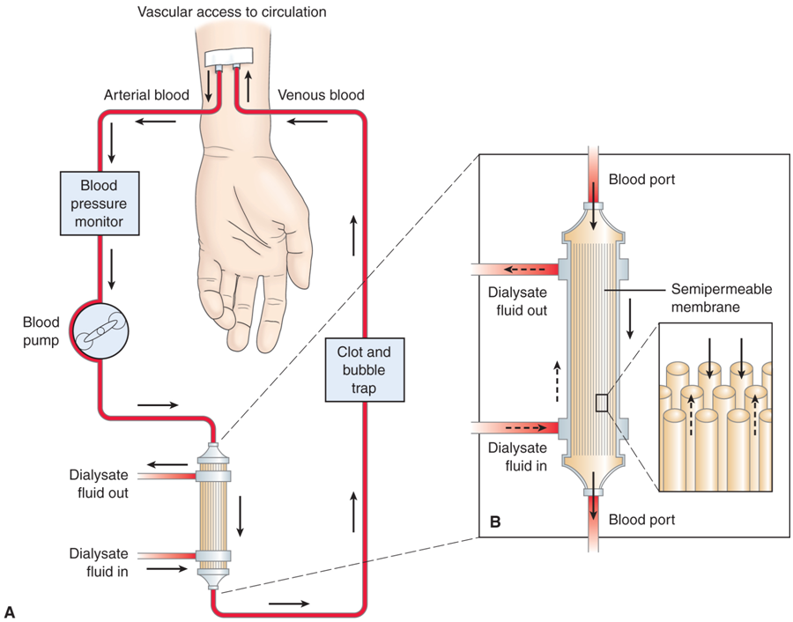

Slide 49
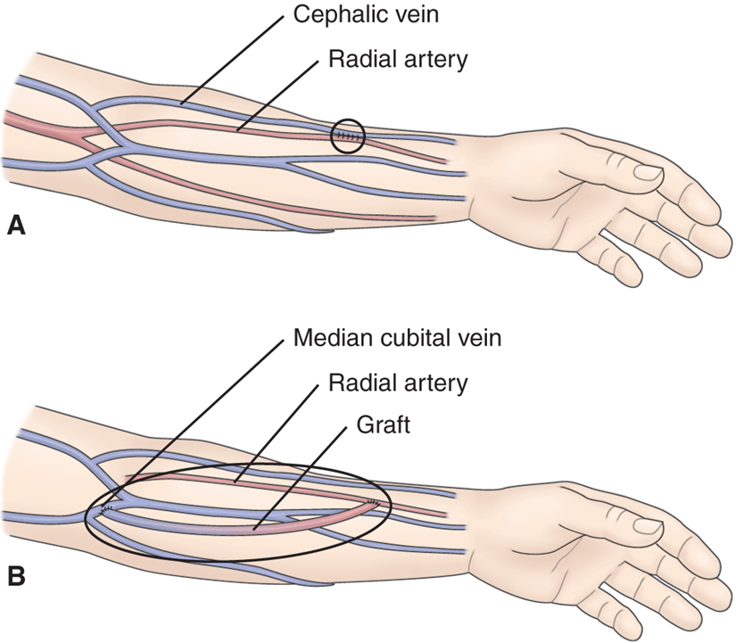

Slide 50
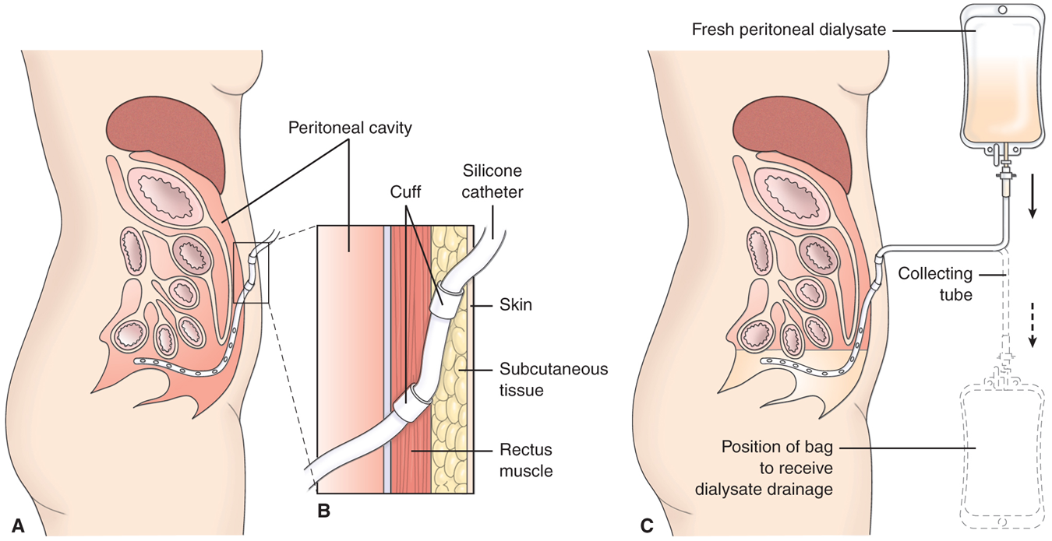

Slide 51
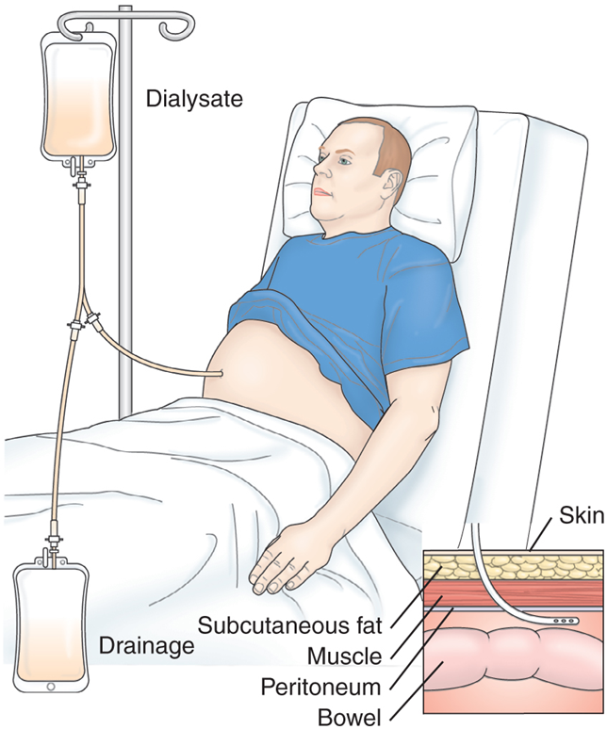

Slide 52
Kidney Transplant
Treatment of choice for many patients with ESRD
Most successful of transplantation procedures
Donor kidney placed in lower abdominal cavity
Grafted organ stimulates an immune response to reject the transplanted organ → immunosuppressive therapy used
Acute rejection develops within months
Hypertension is a possible complication of kidney transplant
Infection is a continuous threat

Slide 53
