Slide 1
Peripheral Vascular Disorders

Slide 2
Objectives
Compare assessment findings typically present in patients with peripheral arterial and peripheral venous disease.
Identify when venous thromboembolism (VTE) and complications of VTE occur.
List nursing interventions to help prevent VTE.
Describe the nurse’s role in monitoring patients who are receiving anticoagulants.
Explain the treatment and care of patients with aneurysms.
Compare Raynaud’s and Buerger’s Disease.

Slide 3
Peripheral Vascular Disease
Arteriosclerosis – thickening, loss of elasticity and calcification of arterial walls
Atherosclerosis – a form of arteriosclerosis → deposits of fat and fibrin that obstruct and harden the arteries.
In the peripheral circulation → these changes impair the blood supply to peripheral tissue → peripheral vascular disease.

Slide 4
Peripheral Vascular Disease
Involves thickening of artery walls → interferes with arterial blood flow to the lower extremities
Affects people in their 6th -8th decades of life.
Risk factors – CHD, Diabetes Mellitus, hypertension, cigarette smoking, elevated C-reactive protein
Regular daily exercise → is a primary intervention for all types of PAD

Slide 5
Peripheral Vascular Disease
Assessment
intermittent claudication
rest pain
inspection of the skin
diminished/absence of peripheral pulses
characteristics of arterial/venous insufficiency

Slide 6
Diagnostic Tests
Angiography
Ankle-Brachial Index
Doppler Ultrasound
Notes:
Angiography is the definitive test for demonstrating the arterial anatomy. For a lower extremity evaluation, the examination must include the abdominal aorta and the entire lower extremity to the foot.
Segmental blood pressure is used to measure actual limb BP. The purpose of these measurements is to look at arterial occlusion.
In the leg pressures are measured at the ankle, below the knee, above the knee and mid-thigh. In the arm, pressures are measured at the wrist, below the elbow, above the elbow and mid upper arm.

Slide 7
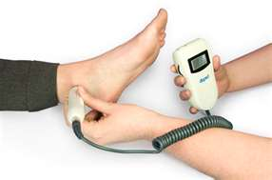
Doppler Ultrasound
Used to hear the blood flow in vessels.
Excessive pressure is avoided because severely diseased arteries can collapse with even minimal pressure.

Slide 8
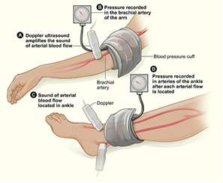
Ankle-Brachial Index
Ratio of ankle to arm BP
Normal index is 1
Less than 0.9 indicative of PAD (arterial disease)
Notes:
An abnormal ABI should alert the clinician to the fact that this group of patients is at risk for early mortality from cardiovascular causes, ie, myocardial infarction, stroke, other vascular death. The goal for treatment of asymptomatic patients is to reduce the risk of subsequent vascular events.

Slide 9
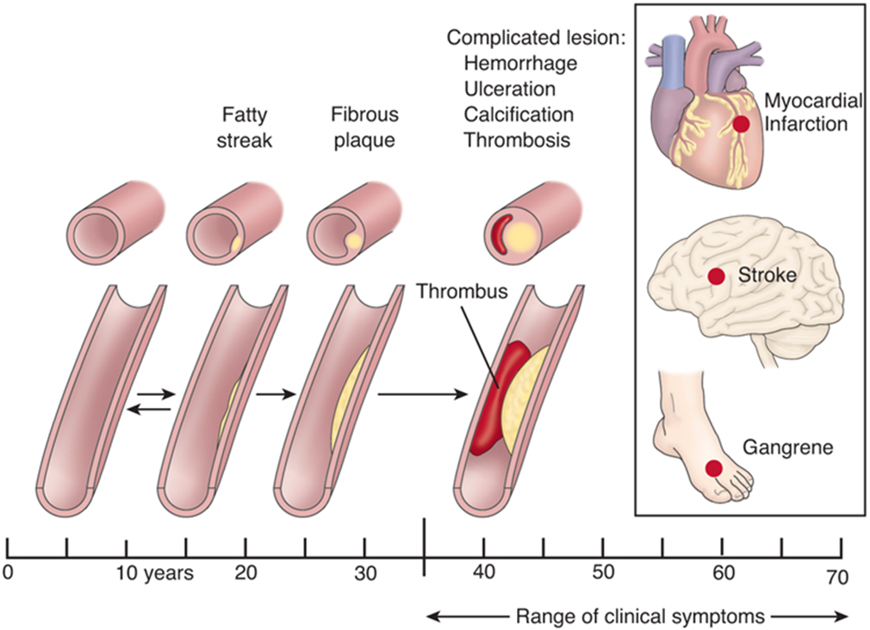

Slide 10
PAD Treatment
Exercise /positioning
Treatments –smoking cessation/meticulous foot care
Revascularization
Drug therapy
Trental (Pentoxifylline)
Pletal (Cilostazol)
Antiplatelet agents
ASA, Plavix
Notes:
All patients require aggressive risk factor modification, including smoking cessation and control of diabetes, dyslipidemia, hypertension, and hyperhomocysteinemia. β-Blockers are safe unless PAD is very severe.
Exercise—35 to 50 min of treadmill or track walking in an exercise-rest-exercise pattern 3 to 4 times/wk. Increases collateral circulation, improves endothelial function with microvascular vasodilation, decreases blood viscosity, improves RBC filterability, decreases ischemia-induced inflammation, and improves O₂ extraction.
Patients are advised to keep the legs below heart level.
Patients are also advised to avoid cold and drugs that cause vasoconstriction (eg, pseudoephedrine, contained in many sinus and cold remedies).
For relief of claudication, pentoxifylline (TRENTAL) or cilostazol (PLETAL) improves blood flow and enhances tissue oxygenation in affected areas;
Antiplatelet drugs may modestly lessen symptoms and improve walking distance; more importantly, these drugs modify atherogenesis and help prevent acute coronary syndromes and transient ischemic attacks

Slide 11
Impaired Tissue Perfusion
Assess peripheral pulses
Position extremities dependent
Avoid smoking
Encourage exercise
Use foot cradles, lightweight blankets
Avoid electric heating pads/hot water bottles

Slide 12
Relieving Pain
Assess pain → chronic, continuous, disabling
Limits activities
Teach pain relief/stress reduction techniques
Analgesic:
hydrocodone/acetaminophen (Vicodin)
oxycodone/acetylsalicylic acid (Percodan)
oxycodone/acetaminophen (Percocet)

Slide 13
Impaired Tissue Integrity
Assess and document skin condition
Provide meticulous daily skin care
Regular inspection of extremities any evidence of infection or inflammation
Apply egg crate/bed cradle
Good nutrition, low-fat diet

Slide 14
Aneurysms
Abnormal dilatation of a blood vessel → commonly at a site of weakness/tear in blood vessel wall.
Bulge or ballooning in wall of artery
Hypertension is a major contributing factor
Commonly affect the aorta/major peripheral arteries
Notes:
Congenital – born with it
Disease is usually Atherosclerosis or HTN

Slide 15
Aneurysms
Congenital or Disease
True Aneurysm
False Aneurysm
Dissecting aneurysm

Slide 16
Aneurysms

Slide 17
Thoracic Aortic Aneurysm
Weakening of the aortic wall by arteriosclerosis & hypertension
Common site for dissecting aneurysm
Frequently asymptomatic
Substernal, neck or back pain
Dyspnea, cough
Hoarseness, dysphagia
Complications
Medical management
Notes:
Most small and slow-growing thoracic aortic aneurysms don't rupture, but large, fast-growing aneurysms may. Depending on the size and rate at which the thoracic aortic aneurysm is growing, treatment may vary from watchful waiting to emergency surgery. Once a thoracic aortic aneurysm is found, doctors will closely monitor it so that surgery can be planned if it's necessary.

Slide 18
Abdominal Aortic Aneurysm
Most common
Occur mostly below the renal arteries
Pulsating mass in mid and upper abdomen with bruit over mass
Complaints of mild to severe mid-abdominal or back pain
Cool, pale or cyanotic lower extremities
Complications
Notes:
Bruit –swishing sound in large arteries – heard with stethoscope

Slide 19
Aortic Dissection
Life-threatening emergency
Sudden tear in the intima of the aorta with hemorrhage into the media
Hemorrhage dissects or splits the vessel wall
Occurs anywhere along the aorta
Hypertension major contributing factor
Pain → ripping, tearing sensation
Complications
Potential surgical repair
Notes:
Emergency situation
Ascending aorta tear – surgery
Descending aorta tear – Medications to lower BP and heart rate
stent to repair tear
Surgery – cardiopulmonary bypass

Slide 20
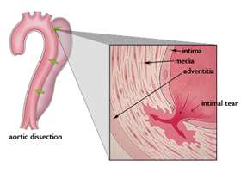

Slide 21
Interdisciplinary Care
Diagnosis
Chest or abdominal X-ray
CT scan
Abdominal ultrasound
Treatment
Antihypertensive medications
Surgery – endovascular stent graft

Slide 23
Endovascular Repair of AAA
High risk patients
Shorter hospital stay
Monitor for complications
Notes:
Used if patient is high risk for abdominal surgery
Complications – need open surgery, bleeding, aneurysm rupture, peripheral embolization, graft misplacement

Slide 24
NURSING INTERVENTIONS

Slide 25
Risk for Ineffective Tissue Perfusion
Reduce the risk of aneurysm rupture
Continuously monitor cardiac rhythm
Report manifestations of arterial embolism
Immediate report changes in mental status or symptoms of peripheral impairment
Notes:
VS hemodynamic monitoring for cardiac output, assessing for s/s of MI
Neurovascular check to assess for graft occlusion or rupture
Pt may have lost blood during surgery – so renal failure can occur if kidneys were not perfused
Parlaytic ileus is expected – NG tube to suction, assess bowel sound, MD may start fluids early to start peristalsis

Slide 26
Anxiety
Explain all procedures and treatments
Respond to all questions honestly
Provide care in a calm, efficient manner
Spend time with the client

Slide 27
Venous Thrombosis
Blood clot forms on the wall of the vein → inflammation, obstructed blood flow
DVT – common complication of surgery and immobility
Virchow’s triad – stasis of blood, vessel damage, and increased blood coagulation
DVT – usually asymptomatic
dull aching pain
possible tenderness, warmth along affected vein
edema/cyanosis affected extremity

Slide 28
Venous Disorders
Interdisciplinary Care
Duplex venous ultrasonography
Plethysmography
MRI

Slide 29
DVT Prevention/Prophylaxis
Medications
Low –molecular weight heparin
Interventions
Rest
Medications
Elevation of extremity
Compression Therapy
stockings
external compression devices
intermittent pneumatic compression devices

Slide 30
Heparin Therapy
Interferes with the clotting cascade → prevents formation of stable fibrin clot
Monitor/report any abnormal lab results and aPTT
Administer deep subQ
Use infusion pump –when given IV
Protamine Sulfate on hand
Report evidence of bleeding
Patient teaching
Notes:
Heparin acts as an anticoagulation by forming a complex with antithrombin, catalysing the inhibition of several activated blood coagulation factors: XIIa, XIa, IXa, Xa and thrombin.
aPTT – activated partial thromboplastin time –
Bleeding precautions: guaiac stool, monitor urine, no razors (electric shaver), limit injections, soft bristled toothbrush

Slide 31
Low-Molecular Weight Heparin
Lovenox (enoxaparin), Fragmin (dalteparin)
Provide a more precise and predictable anticoagulant effect than heparin
Suitable for home-care
Report excessive bruising/bleeding
Do not take ASA, NSAIDs
Administer subQ
Notes:
Protamine sulfate is the antidote – but rarely needed

Slide 32
Coumadin
Inhibits synthesis of vitamin K dependent clotting factors
3 – 4 days until therapeutic
Monitor INR (1.5 – 2.0)
Take at the same time every day
Bleeding precautions
Antidote: Vitamin K
Wear Medic-Alert tag
Notes:
Started when pt is on heparin,
The half-life of warfarin ranges from 20 to 60 hours. The mean plasma half-life is approximately 40 hours, and the duration of effect is two to five days. Thus, the maximum effect of a dose occurs up to 48 hours after administration, and the effect lingers for the next five days.
Clot busters
Recombinant tissue plasminogen activator or platelet inhibitors
Catheter directly into clot
Experimental for peripheral vascular occlusions

Slide 33
NURSING INTERVENTIONS

Slide 34
Pain
Regularly assess pain location
Measure calf and thigh diameter
Apply warm, moist heat to affected extremity

Slide 35
Ineffective Tissue Perfusion: Peripheral
Assess for peripheral pulses, skin integrity
Assess the skin of the affected lower leg and foot
Elevate extremities
Monitor lab results

Slide 36
Impaired Physical Mobility
Encourage ROM exercise
Encourage frequent position changes
Encourage increased fluid and dietary fiber intake
Provide diversional activities

Slide 37
Leg Ulcers
Excavation of the skin surface that occurs when inflamed necrotic tissue sloughs off.
75% of leg ulcers → chronic venous insufficiency
20% of leg ulcers → arterial insufficiency
Cellular metabolism cannot maintain energy balance → cell death (necrosis)

Slide 38
Arterial Ulcers
Arterial thrombosis /arterial embolism = tissue ischemia
Ischemic tissue → painful, pale, cool, cold
Distal pulses may be absent
Absence of hair on the toes or the legs
Claudication present
Ulcers are most likely → perfectly round, smooth edges, minimal drainage, no odor

Slide 39
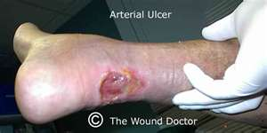
Arterial Ulcers

Slide 40
Venous Ulcers
Over medial or anterior ankle
Lower leg edema/may be cyanotic
Aching, cramping pain
Pulses present, may be difficult to palpate
Brownish pigmentation to the skin
Skin changes – stasis dermatitis
Shape – irregular border

Slide 41
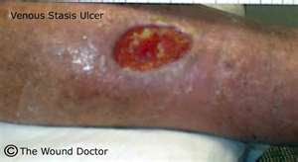
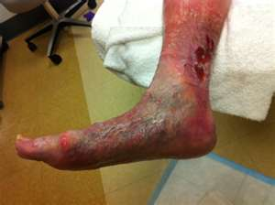
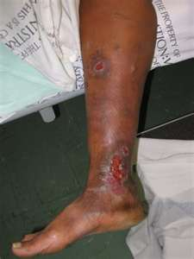
Venous ulcers

Slide 42
Interdisciplinary Care
Reduce edema
Treat ulcerations

Slide 43
Nursing Assessment
Extent and type of pain
Peripheral pulses
Mobility
Assess for presence of infection
Assess nutrition

Slide 44
Mobility
With leg ulcers, activity is usually initially restricted to promote healing
Gradual progression of activity
Activity to promote blood flow; encourage patient to move about in bed and exercise upper extremities
Diversional activities
Pain medication prior to activities

Slide 45
Other intervention
Skin integrity
Skin care/hygiene and wound care
Positioning of legs to promote circulation
Avoidance of trauma
Nutrition
Measures to ensure adequate nutrition
Adequate protein, vitamin C and A, iron, and zinc are especially important for wound healing
Include cultural considerations and patient teaching in the dietary plan

Slide 46
Raynaud’s Disease
Intense vasospasm in the small arteries of the fingers
Pallor, coldness, numbness, cyanosis and pain
Occurs in young women
Aggravated by cold and stress
Blue-white-red changes
Treatment
Vasodilators/Calcium Channel Blockers
Sympathectomy
Interventions
Notes:
Cold-stimulation test may involve placing your hands in cool water or exposing you to cold air, to trigger an episode of Raynaud's
Calcium channel blockers. These drugs relax and open up small blood vessels in your hands and feet. They decrease the frequency and severity of attacks in most people with Raynaud's. Examples include nifedipine (Procardia), amlodipine (Norvasc) and felodipine (Plendil).
Alpha blockers. Counteract the actions of norepinephrine, a hormone that constricts blood vessels. Examples include prazosin (Minipress) and doxazosin (Cardura).
Vasodilators. Relaxes blood vessels — such as nitroglycerin cream to your fingers to help heal skin ulcers. Other drugs used are high blood pressure drug losartan (Cozaar), the erectile dysfunction medication sildenafil (Viagra), the antidepressant medication fluoxetine (Prozac), and a class of medication called prostaglandins.
Nerves called sympathetic nerves in your hands and feet control the opening and narrowing of blood vessels in your skin. Surgery, called sympathectomy, may reduce the frequency and duration of attacks, but it's not always successful.
Some medications actually can aggravate Raynaud's by leading to increased blood vessel spasm. Avoid taking:
Certain over-the-counter (OTC) cold drugs. Examples include drugs that contain pseudoephedrine (Actifed, Chlor-Trimeton, Sudafed).
Beta blockers. This class of drugs, used to treat high blood pressure and heart disease, includes metoprolol (Lopressor, Toprol), nadolol (Corgard) and propranolol (Inderal, Innopran XL).
Birth control pills. If you use birth control pills, you may wish to switch to another method of contraception because these drugs affect your circulation and may make you more prone to attacks

Slide 47
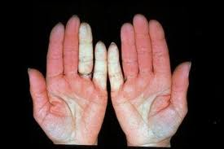

Slide 48
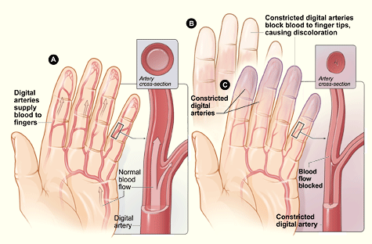

Slide 49
Buerger’s Disease
Occlusive vascular disease → small and medium sized arteries become inflamed and spastic/veins
Often affects the leg/foot
Cigarette smoking – significant cause of disease
Disease is intermittent → exacerbations/remissions
Pain - affected extremities
Extremities/digits → pale, cyanotic, cool/cold to touch
Notes:
Buerger’s disease (also called thromboangiitis obliterans) is an inflammatory vascular disorder that primarily affects small and medium sized arteries of both the upper and lower extremities. It most frequently develops in men under the age of 40 with prevalence in the Asian and Eastern European populations. The disorder results in the infiltration of inflammatory cells (white cells and mononuclear cells) into the wall of the blood vessels. Over time, this inflammatory response is replaced by fibrosis and vessel occlusion.

Slide 50
Buerger’s Disease
Diagnosis
History/physical exam
Doppler studies
Interdisciplinary Care
Smoking cessation
Prevent vasoconstriction
Improve peripheral blood flow
Surgical approaches - sympathectomy

Slide 53
QUESTION
The nurse notes that the client’s leg below the knee is cool, pale, and dorsalis pedis & posterior tibia pulses are absent. The priority nursing intervention is to do which of the following?
Notify the healthcare provider.
Prepare to initiate heparin therapy.
Position the leg flat, supported in anatomic position.
Place a cradle over the leg to prevent pressure from bedding.

Slide 54
QUESTION
All of the following are appropriate home care measures for the patient with PVD. Place them in order of priority.
Foot and leg care
Smoking cessation
Daily inspection of feet and legs
Regular daily exercise
Weight loss strategies

Slide 55
QUESTION
The nurse evaluates her teaching plan for a patient with deep vein thrombosis has been effective when the patient stated?
“I’ll use a hard-back chair, upright chair when sitting instead of my recliner.”
“I understand why I am not allowed to exercise for the next 6 weeks.”
“I’ll get my bloods drawn as scheduled and notify the doctor if I have unusual bleeding.”
“I’ll have my wife start to prepare low-cholesterol meals and will speak with the dietitian.”

