Slide 1
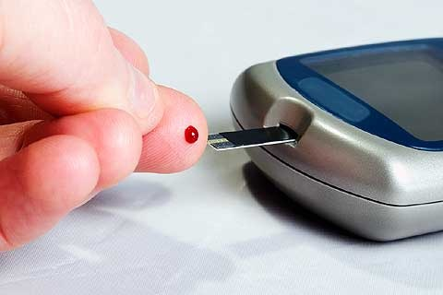
Diabetes Mellitus Part I
Care Of The Patient With Diabetes Mellitus
M. Gardner
NUR 224

Slide 2
Diabetes Mellitus
Definition
Facts About Diabetes
Etiology and Pathophysiology
Types of Diabetes
The Role of Insulin
Risk Factors

Slide 3
Diabetes Mellitus
Diabetes Mellitus is a chronic multisystem disease related to:
Abnormal Insulin Production
Impaired Insulin Utilization
OR
Abnormal Insulin Production AND Impaired Insulin Utilization

Slide 4
Facts
7% of the General Population (20.8 million people) have Diabetes Mellitus
14% (41 million people) have Pre-Diabetes
6 Million undiagnosed (unaware) Diabetics
3th Leading Cause of Death from disease in the U.S.
Likely to go underreported
Annual cost exceeds $174 billion
$92 billion direct medical costs

Slide 5
More Facts
Highest incidence among Native Americans (15%)
Pima Indians in Arizona have highest rate of diabetes in the world (50% of adult population)
Complications of diabetes more common in Native Americans and African Americans than in Caucasians
Rate of ESRF is 6 times higher among Native Americans
Incidence higher among African Americans and Hispanics than Caucasians

Slide 6
Facts (cont’d)
The long-term complications of Diabetes makes it a devastating disease
Diabetes is a leading cause of:
Adult blindness
End stage renal disease
Non-traumatic lower limb amputations
Major contributor to:
Heart disease
Stroke
Hypertension

Slide 7
Etiology and Pathophysiology
Diabetes is a disorder of glucose metabolism related to absent or insufficient insulin supplies and/or poor utilization of the insulin that is available.
Causes may be:
Genetic
Autoimmune
Viral
Environmental

Slide 8
Etiology and Pathophysiology (cont’d)
Beta cells secrete the hormone Insulin →which facilitates the movement of glucose across cell membranes into the cells decreasing blood glucose levels.
Under normal conditions, insulin continuously released into the bloodstream
When food is ingested, more insulin is released and glucose moves from the blood to the liver, muscle and fat cells.

Slide 9
Etiology and Pathophysiology (cont’d)
In those cells – insulin:
* transports and metabolizes glucose for energy
* stimulates storage of glucose in the liver and
muscle (in the form of glycogen)
* accelerates transport of amino acids in to the
cells
Insulin inhibits the breakdown of stored glucose,
fat and protein.

Slide 10
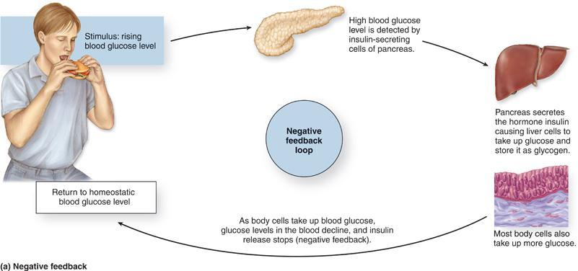

Slide 11
Patho
Pancreatic hormone -- Glucagon
Secreted by the alpha cells of the islets of Langerhans
Released when blood glucose is decreased
Stimulates the liver to release stored glucose

Slide 12
The Role of Insulin
Primary role is to decrease the concentration of glucose circulating in the bloodstream
Stimulates the liver to store glucose in the form of glycogen (absorbed by the intestines, sent to the liver to change into glycogen)
Promotes the synthesis of fatty acids in the liver
Inhibits the breakdown of fat in adipose tissue - indirectly stimulates accumulation of fat in adipose tissue.

Slide 13
Blood Glucose Homeostasis
High blood glucose → pancreas releases insulin→ cells take up glucose from the blood/liver produces glycogen → blood glucose falls
Low blood glucose → pancreas releases glucagon→ liver breaks down glycogen→ blood glucose rises

Slide 14
Types of Diabetes
Type 1 Diabetes
Type 2 Diabetes
Pre-Diabetes

Slide 15
Type 1 Diabetes
Type I Diabetes is an autoimmune disease caused by the inability of the body to produce insulin
Formerly known as Juvenile Diabetes
Body’s own T-cells attack & destroy beta cells in the pancreas
Caused by genetic predisposition

Slide 16
Type I Diabetes (cont’)
Long preclinical period
Can take months to years before clinical manifestations appear because symptoms occur when the pancreas can no longer produce insulin
Once pancreas can no longer produce insulin, the onset of symptoms is usually rapid

Slide 17
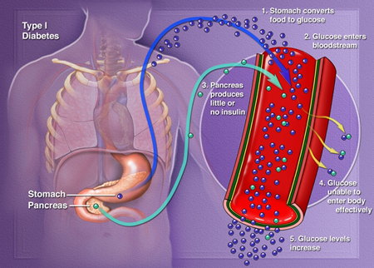

Slide 18
Symptoms of Type 1 Diabetes
Rapid onset, patient in ER with impending or actual diabetic ketoacidosis (DKA)
History of sudden, recent weight loss
Classic Symptoms:
Type 1 Diabetics require insulin from an outside source

Slide 19
Prediabetes
Prediabetes is the state that occurs when a person's blood glucose levels are higher than normal but not high enough for a diagnosis of diabetes.
Also known as Impaired Glucose Tolerance or Impaired Fasting Glucose
Most people with prediabetes develop Type 2 Diabetes within 10 years if no interventions

Slide 20
Prediabetes (cont’d)
Fasting Blood Glucose (FBG) Levels higher than normal
>100mg/dl but <126 mg/dl
Long term damage to the body (associated with diabetes) already occurring in patients with prediabetes
Usually asymptomatic
Prediabetics should be encouraged to take their blood glucose readings regularly & watch for
S & S of diabetes

Slide 21
Prediabetes (cont’d)
Patients with prediabetes can delay or prevent the development of type 2 diabetes with interventions:
Maintain healthy weight
Regular Exercise
Healthy diet

Slide 22
Type 2 Diabetes Mellitus
Formerly known as ‘adult onset’ diabetes
Most prevalent type (over 90% of diabetics)
Usually occurs in people >30 yrs old
Half over the age of 55
80%-90% patients overweight at time of diagnosis
Now being seen in children and young adults
Probably has genetic basis – runs in families

Slide 23
Type 2 Diabetes
Type 2 Diabetes is caused by the inability of the body to produce enough insulin or insulin is poorly utilized
The pancreas continues to produce insulin
Not enough insulin
Inability of the body to use the insulin effectively
The production of insulin is the major pathophysiological difference between type 1 and type 2 diabetes

Slide 24
Type 2 Diabetes: Risk Factors
Obesity - especially abdominal and visceral adipose tissue
Genetic
Insulin Resistance
Can be genetic link to Obesity
Metabolic abnormalities that contribute to development of type 2 diabetes
Insulin Resistance
Inability of pancreas to produce insulin
Inappropriate glucose production by the liver

Slide 25
Insulin Resistance
Tissue does not respond to the action of insulin
Insulin receptors unresponsive and/or insufficient in number
Most insulin receptors located on:
Skeletal muscle
Fat cells
Liver cells
Entry of glucose into the cell is impeded, resulting in hyperglycemia

Slide 26
Decreased Insulin Production
Beta cells become fatigued from compensatory overproduction of insulin
Cause is unknown, but linked to adverse effects of chronic hyperglycemia or high circulating free fatty acids

Slide 27
Inappropriate Glucose Regulation/Metabolism
The liver does not regulate the release of glucose properly – releases haphazardly
The glucose stored by the liver is not released in accordance with blood glucose levels

Slide 28
Metabolic Syndrome
Metabolic Syndrome: A cluster of abnormalities that act synergistically to greatly increase the risk for cardiovascular disease and diabetes
Characterized by:
Insulin resistance
Elevated insulin levels
Hypercholesterolemia
Abdominal obesity
Hypertension

Slide 29
Metabolic Syndrome
Obesity
Fasting Blood Glucose >110
High HDL
High
Tri-glycerides
Hypertension

Slide 30
Risk Factors for Metabolic Syndrome
Central Obesity
Sedentary lifestyle
Ethnicities
Native Americans
Hispanics
African Americans
Overweight individuals with metabolic syndrome can prevent or delay the onset of diabetes with weight loss and regular exercise

Slide 31
Type 2 Diabetes
Slow progressive glucose intolerance
Onset – undetected for years
May experience – fatigue, irritability, polyuria, polydipsia, poorly healed skin wounds
Long term complications may develop before the diagnosis is actually made
* eye disease
* peripheral neuropathy
* peripheral vascular disease

Slide 32
Type 2 Diabetes
Clinical manifestations
Three P’s – polyuria, polydipsia, polyphagia
Fatigue, weakness
Sudden visual changes, tingling/numbness hands and feet
Dry skin
Skin lesions/wounds that are slow to heal
Recurrent infections

Slide 33
Diabetes
Diagnostic Studies

Slide 34
Diagnoses
Methods for diagnosing (any kind of) Diabetes
Fasting Plasma Glucose Level ≥126 mg/dl
Fasting=NPO x 8 hours
Random or casual plasma glucose measurement ≥200 mg/dl plus the presence of clinical manifestations of diabetes
Casual= any time of day without regard to time of the last meal
Two-hour postload glucose ≥200 mg/dl using glucose load of 75 g.

Slide 35
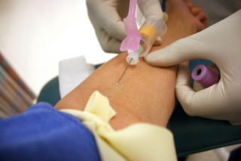
Random/Casual Plasma Glucose Test
No Fasting is Required
Diagnosis=Positive for Diabetes if measurements ≥200 mg/dl plus the presence of any clinical manifestations

Slide 36
Two Hour Postload
Accuracy depends on adequate patient preparation and history taking
The following can cause falsely elevated blood glucose values
Recent severe restrictions of carbohydrates
Acute illness
Medications
Restricted activity
Impaired gastrointestinal absorption

Slide 37
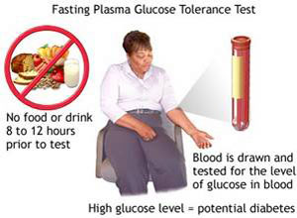
Fasting Plasma Glucose (FPG) Test
Repeated if the result is high
( ≥126)
Usually followed up with a two hour OGTT

Slide 38
Glycosated Hemoglobin (aka HbA1C)
NOT a diagnostic test to confirm diagnosis of Diabetes
Determines the glycemic index over time
Used by diabetics & physicians to monitor success of treatment and make changes
Shows the amount of glucose that has been attached to hemoglobin molecules over their life span

Slide 39
Hemoglobin A1C (cont’d)
How it works:
When blood glucose is elevated over time, the amount of glucose attached to the hemoglobin module increases and remains attached to the RBC for the life of the cell (120 days)
An HbA1C test can indicate the glucose control (or lack of control) for the past 90-120 days

Slide 40
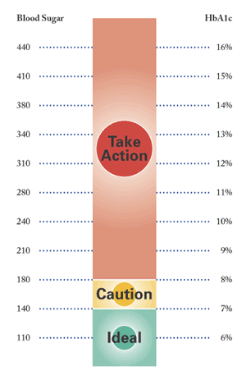
Hemoglobin A1C
American Diabetes Association recommends diabetics maintain a HgA1C level ≤ 7%
American College of Endocrinology recommends HgA1C level ≤ 6.5%
Both organizations recommend regular assessment of HgA1C levels be done

